Slide 1
Course Overview:
CSE 2215 - Lecture 1 - Fall 2023
Instructor : Shekh. Md. Saifur Rahman, Lecturer, Dept. of CSE , UIU

Slide 2
Overview
Introduction to Data Structures
Linear/Non linear Data Structures
Complexity Analysis
Best-worst Case

Slide 3
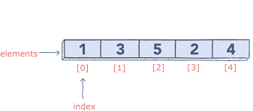
Overview
Array

Slide 4
Overview
Insertion Sort Example
Array Sorting
Insertion Sort
Quick sort
Merge sort
Counting sort

Slide 5
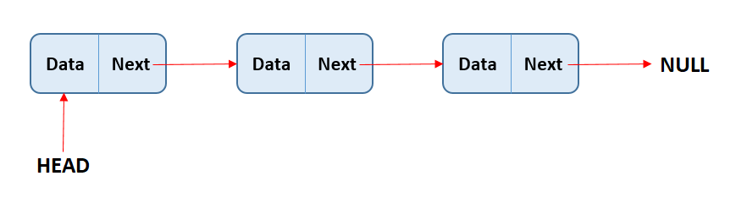
Overview
Linked List

Slide 6
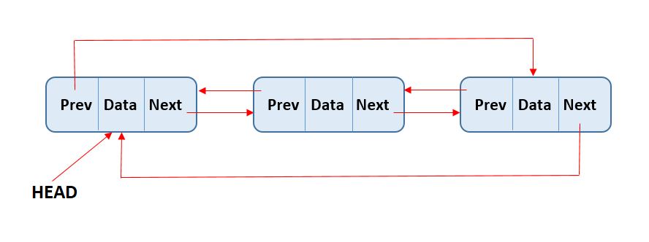
Overview
Linked List Types
Single Linked List
Double Linked List
Circular Linked List

Slide 7


Overview
Stack
Queue

Slide 8
Overview
Trees
Binary Search Tree
Tree Traversal
Implementation
Properties

Slide 9
Overview
Heap
Priority Queue

Slide 10
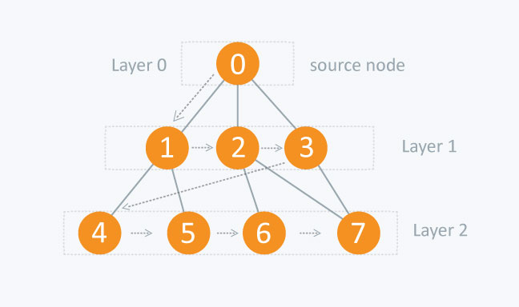
Overview
Graph
Adjacency List , adj. Matrix
BFS
DFS and Topological Sort
Applications

Slide 11
Assignments and Grading
Class tests & Assignments (25% in total)
3-4 class tests (avg. of best (n-1)).
Take home problem sets/Assignment.
Midterm (30%).
Final Exam (40%).
Attendance(5%).

Slide 12
Some Tips
This class can be time consuming.
Understanding the material takes time.
Don’t skip topics. Seek help until you don’t understand completely.
Don’t bother too much about exam question pattern.
Learn the class material as closely as possible.
Do not underestimate the workload.
A task left for tomorrow is a task left undone.
Planning and scheduling your time is essential.
Don’t be afraid to ask questions.

Slide 13
Thank You

